Slide 1

URN 6931086 Conference paper: How the Layout of Cities Influences Pollution
By: Oliwier Szamrowicz

Slide 2
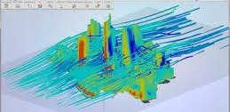
Introduction
The city environment has a heavy impact on the air around it as the wind can be disrupted by the city line.
Tall buildings bunched up together hinder the airflow and in most circumstances cause vortex’s on the back face of the building.
Vortex's are areas of changing pressure where the air moves in circular patterns, this refreshes the air between the buildings and removes a portion of air bourn pollutant matter.
Air pollution stays withing 10 metres above the ground so the city needs regulated airflow to keep the air clean, on sunny windless days nitrogenous particles can react with sunlight to form smog which can be harmful to all life and be quite smelly.

Slide 3
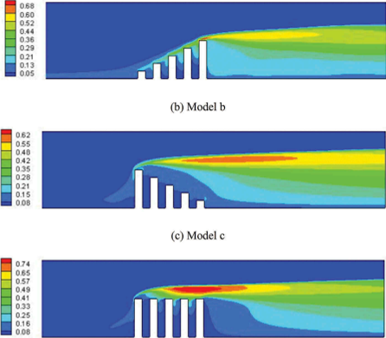
Analysis of Building Layouts Height Arrangement
Arranging the buildings in ascending order allows more buildings to have “a portion of the wind” to evenly clear the air from that buildings pass.
Having multiple buildings of the same height next to one another makes the wind “diffuse” behind the buildings and make a weak vortex behind its back face, moving some but very little air from between the buildings.
Building the city in descending order of height is the worst combination as the taller buildings shield the smaller ones from the wind so very little airflow is between them and the air becomes still so pollutants are more present.

Slide 4
Analysis of Building Layouts Dangers of Pollution
Air pollution causes 3,68 million premature deaths each year due to diseases like leukaemia and is associated with non Hodgkin’s lymphoma multiple types of cancer, such as breast cancer, lung cancer, colorectal and prostate cancer.
Pollution also causes fatigue, faster calcification of arteries, impairs blood vessel function, increases chances of stroke and respiratory problems like asthma, emphysema, chronic obstructive pulmonary disease and chronic bronchitis.

Slide 5
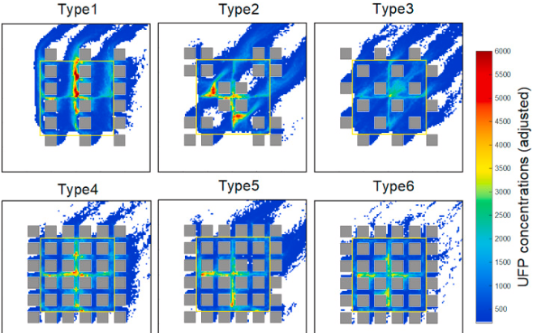
Analysis of Building Layouts Layout Solution
Skyscrapers should be separated by shorter apartment buildings to allow the wind to pass more freely through the city.
The height of the buildings should increase in the direction of the wind for reasons previously stated.
The city should be built in an even grid pattern so the wind has a straight pathway through the city streets, this makes removing the bottom 10 metres of polluted air easier.
Thank you for listening to my presentation.

